Slide 1
Yellowfin tuna (Thunnus albacares), the Mexican Purse Seine fleet, and oceanography in the Eastern Pacific
ESM266
Juan Carlos Villaseñor-Derbez
June 08, 2017

Slide 2
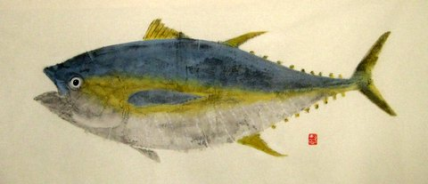
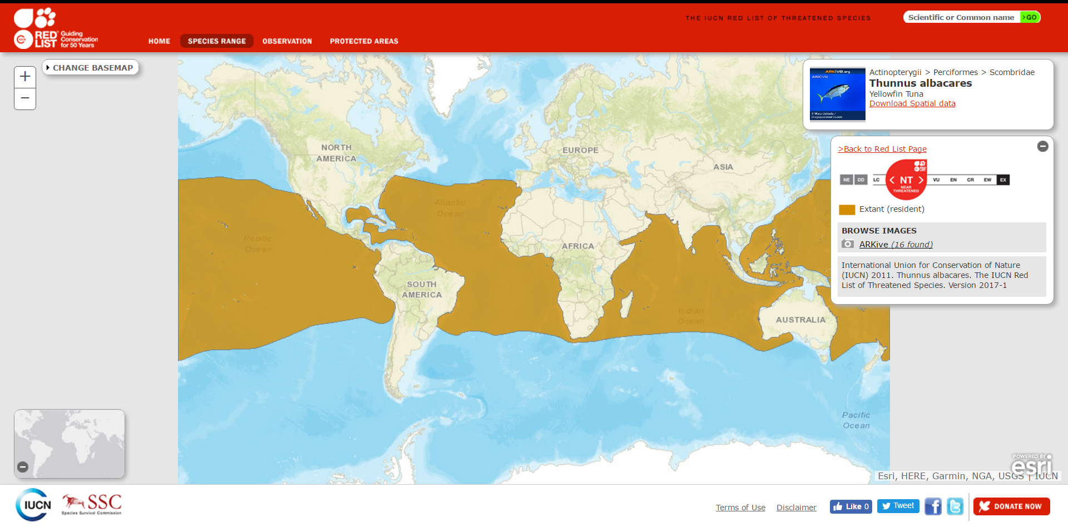
Introduction
Yellowfin tuna fishery
Important fishery in Mexico
Near Threatened (IUCN, 2016)

Slide 3
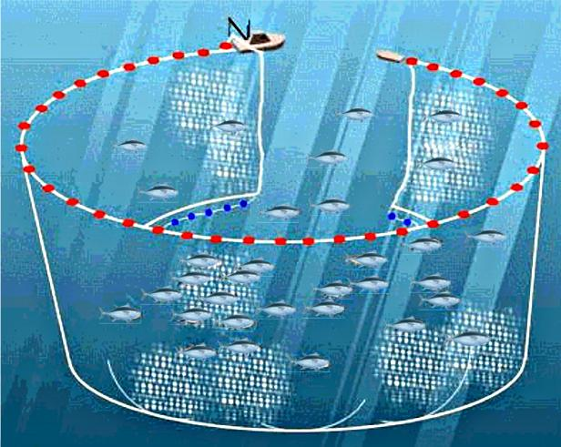
Introduction
Purse seining:
Dolphin-associated schools (75%)
Free-swimming schools (20%)
FADs (5%)
Net drops up to 200 m (pacific)
Evidence that ENSO causes null sets (Dreyfus et al., 2015)

Slide 4
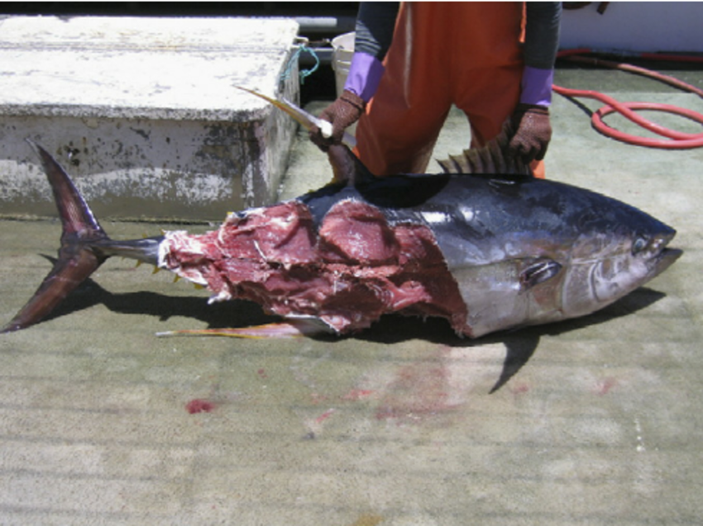
Why look into spatial distribution?
Large marine organisms track oceanographic features
(Cox et al., 2016, Palacios et al., 2006)
Biodiversity hotspots (Worm et al., 2013)
Key areas for conservation / management
Near real-time spatio-temporal management (Hobday & Hartmann, 2006)
Mobile Marine Protected Areas (mMPAs)
Gilman et al., 2008

Slide 5
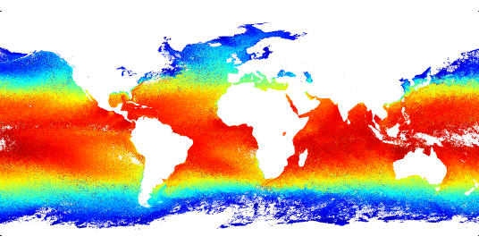
Data
January 2003
Remote sensing data:
Sea Surface Temperature (SST)
MODIS-Aqua
4km spatial resolution (0.041°)
Short-wave SST algorithm
Bands 22 and 23 (3.95, 4.05 µm)
Monthly composite images:
2003 – 2014 (144 images)
https://modis.gsfc.nasa.gov/data/dataprod/mod28.php
ftp://podaac-ftp.jpl.nasa.gov/OceanTemperature/modis/L3/aqua/4um/v2014.0/4km/monthly/

Slide 6
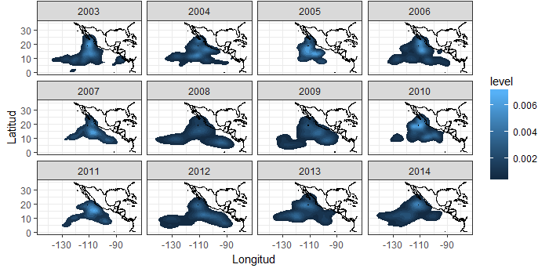
Data
Tuna data:
Mexican Tuna Purse Seine Fleet
On-board scientific observers
Data on at least 50% of the trips
Georeferenced total length measurements (n = 258, 954)

Slide 7
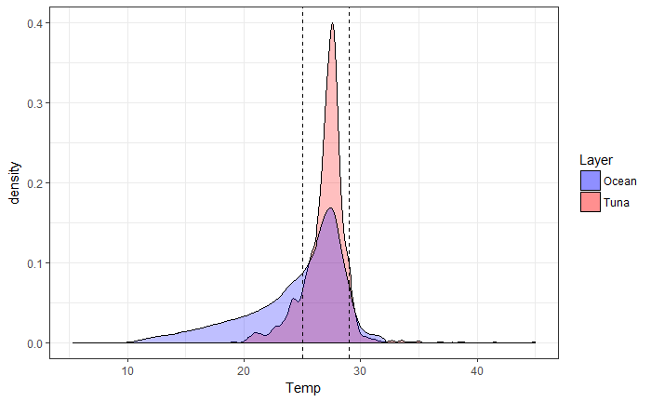
Fleet tracks isotherms
T(7315.8) = 95.36, p < 0.001
Tuna = 27.00 ± 2.01 °C
Ocean = 24.49 ± 2.58 °C

Slide 8
Questions
Why does the fleet track isotherms?
Can fleet behavior inform about tuna distribution?
Is there a relationship between size structures and space?

Slide 9
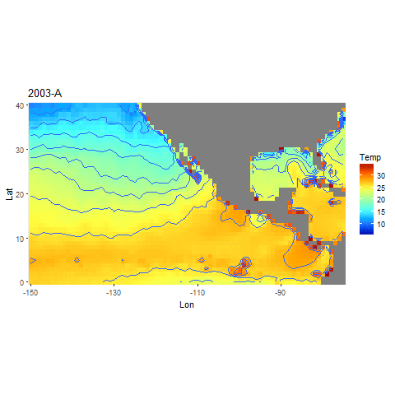

Slide 10
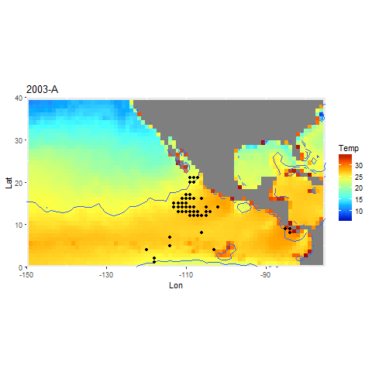

Slide 11
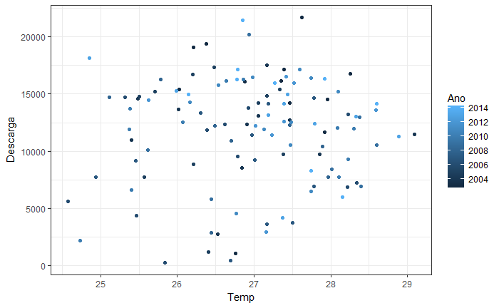
Not because of catches (R² = 0.0426)

Slide 12
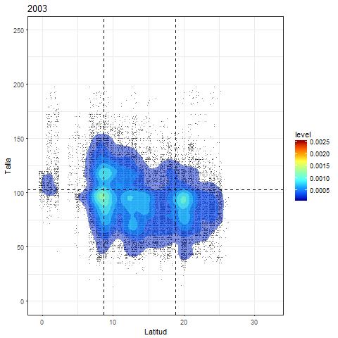

Slide 13
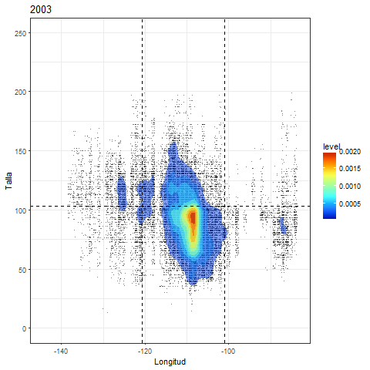

Slide 14
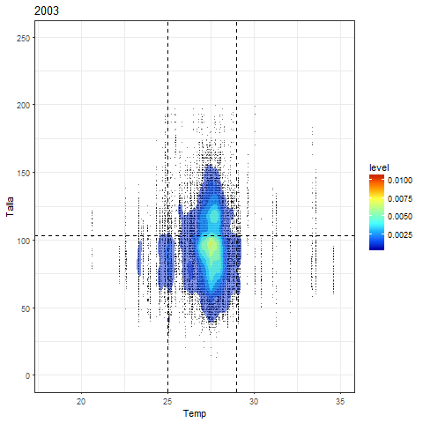

Slide 15
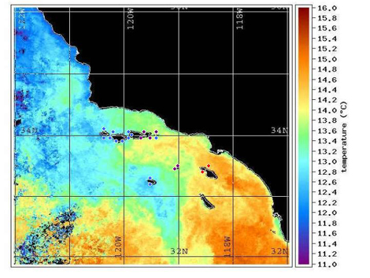
Conclusions
Behavior not explained by catches
Larger organisms found in the 27.00 ± 2.01 °C region
Thermal range in which fleet operates is small
https://cbsurveys.ucsc.edu/findings/islandpatterns.html

Slide 16
Next questions / steps
Does tracking dolphins / tuna maximize revenue?
i.e. is it more profitable to search for many small fish than few large?
YFT and dolphin thermal envelopes (telemetry data)
Climate velocity (spatio-temporal change)
Climate Change implications

Slide 17
function satesst(year)
F1 = ftp('podaac-ftp.jpl.nasa.gov'); %Open ftp
data_save = pwd(); %present working directory
file = ['/OceanTemperature/modis/L3/aqua/4um/v2014.0/4km/monthly/',num2str(year),'/*.nc’];
mget(F1,file,data_save); % Download file using mget
close(F1) %close ftp
end

